Slide 1
Telecom Network

Slide 2
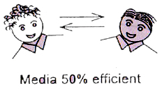
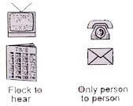
Communication
By Directional Interaction
Public and Personal
Technical Characteristics
Public- Unidirectional Tx does not know how many receivers are ON
Personal – By directional interactive

Slide 3
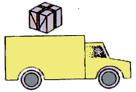
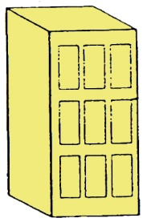
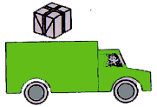
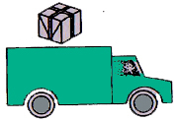
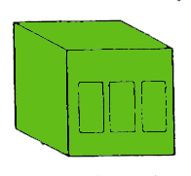
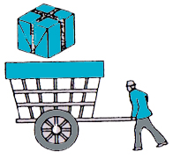
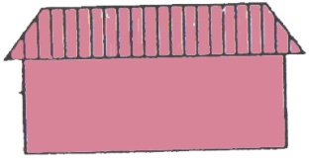
Operation of Domestic Delivery Network
Province deport
District deport
Province deport
Local deport
District deport
Local deport

Slide 4
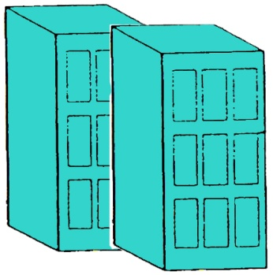
INTERNATIONAL NETWORKS
International Deport of Other Country
Province deport
Deport Other
Country
Province deport
One Country
International Deport of Sri Lanka
Another Country

Slide 5
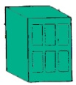
Domestic Transport
Province deport
Province deport
District deport
District deport
Access Network

Slide 6
Telecom Network in Summary
LE
Local EX
LE
03
Domestic Transport
LE
LE
International Transport
LE
LE
IEX
Access
02
IEX
01
Land line
IEX
IEX

Slide 8
Services available to home
FIXED TELEPHONE/ MOBILE TELEPHONE(DIFFERENT SERVICE PROVIDERS)
INTERNET & E MAIL(DIFFERENT SERVICE PROVIDERS)
NORMAL /CABLE/SATTELITE---TV(DIFFERENT SERVICE PROVIDERS)
RADIO(DIFFERENT SERVICE PROVIDERS)

Slide 9
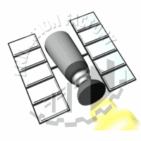
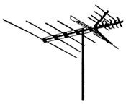
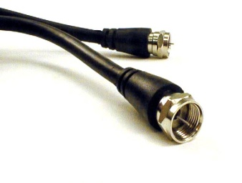
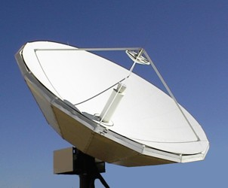
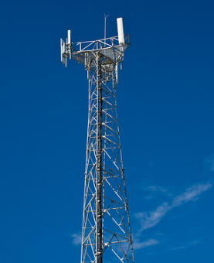
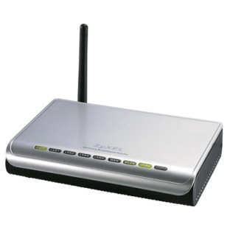
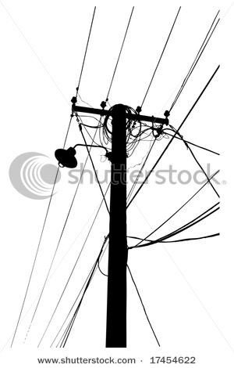
A house got 3 different Communication Types
Voice
Video
Data
How it access home?
Land Phone
Internet
Voice
Mobile
Free TV (Antenna)
Satellite TV
Cable TV
E-mail
Wireless
Wire
Wireless
Data
Wireless
Wire or Wireless
Wire
Video

Slide 10
HOW THEY ACCESS TO HOME
DIFFERENT ACCESS METHODS DEPENDING UPON THE SERVICE PROVIDER.(EXCEPT RADIO & INTERNET, THERE IS A SLIGHT DEVIATION)
DOES SERVICE PROVIDERS NEED TO HAVE THEIR OWN NETWORK?
IS IT ECCONOMICAL?
SERVICE PROVIDERS AND NETWORK PROVIDERS CAN BE SEPERATED.

Slide 11
Fixed Network
MSAN
Local EX
MSAN
03
Domestic Transport
MSAN
MSAN
International Transport
MSAN
Access
IEX
02
01
Fixed
IEX
IEX

Slide 12
Mobile Network
MSAN
Local EX
03
MSAN
MSAN
MSAN
International Transport
MSAN
Access
IEX
02
Radio signals
01
Mobile
IEX
IEX

Slide 13
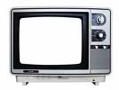
TV Network
MSAN
Local EX
MSAN
03
MSAN
MSAN
International Transport
MSAN
Access
IEX
02
01
IEX
IEX

Slide 14
WHAT ARE THE BASIC TERMINALS YOU NEED TO ACCESS ALL THESE SERVICES AT HOME?
A MICROPHONE
A SPEAKER
A VEDIO SCREEN
A KEY BOARD
THE ABOVE TERMINALS CAN BE FIXED OR MOBILE.
CAN WE CONVERGE ALL THESE INTO ONE TERMINAL?

Slide 15
HOW THEY CARRY INFORMATION TO YOUR HOME?
BY DIFFERENT NETWORKS?
WHEN YOU ARE TRAVELLING FROM NEGOMBO TO COLOMBO BY CTB, DO YOU WANT A SEPARATE ROAD FOR THE CTB BUS TO TRAVEL? IS IT ECCONOMICAL?
NO
DIFFERANT BUS COMPANIES CARRY THEIR PASSENGERS IN ONE OR MOST COMFERTABLE ROAD TO PROVIDE BETTER COMPORT AT A COST EFFECTIVE WAY.
ARE WE GOING TO OPERATE SEPERATE ROADS FOR SEPERATE BUS COMPANIES? NO IT IS UNECCONOMICAL.
SIMILARLY FOR AIR PORTS? IF SRILANKAN WILL HAVE ONE AIRPORT, EMIRATES WIIL HAVE ANOTHER , CAN CUSTOMERS ARE BENEFITTED FOR A COST EFFECTIVE SERVICES?
SOLUTION IS TO HAVE ONE OR TWO TRANSPORT OR ACCESS NETWORK TO CARRY ALL THE SERVICES

Slide 16
WHAT ARE THE INNOVATIVE PRODUCTS?
EARLIER VOICE, DATA & VEDIO SERVICES WERE SEPERATED.(specially for the interactive communications)
New services such as Skype will provide all services with one access line. This is a innovative product which has being used in many years.
In time to come virtual class room , virtual universities will definitely change the way of living of our people in this country.

Slide 17
WHO ARE THE BENIFICIARIES OF A CONVERGED NETWORK
CITIZEN & GOVERNMENT OF THAT COUNTRY
WHY?
CUSTOMERS WILL BE BENEFITTED WITH HAVING ONE TERMINAL TO OPERATE ALL VOICE , DATA & VEDIO SERVICES. FURTHER THEY WILL BE BENIFITTED WITH HAVING ONE ACCESS LINE TO MAINTAIN AT HOME.
CUSTOMERS CAN CHOOSE THE SERVICES INDEPENDENT OF THE NETWORK PROVIDER, AND THE SERVICE PROVIDER CAN ATTRACT THE CUSTOMERS ON BETTER VALUE PROGRAMMES, INDEPENDENT TO THE NETWOPRK PROVIDER.
IS SERVICE & NETWORK PROVIDERS ARE BENIFITTED?
YES. CUSTOMERS WILL BE ATTRACTED TO THE INOVATIVE PRODUCTS

Slide 18
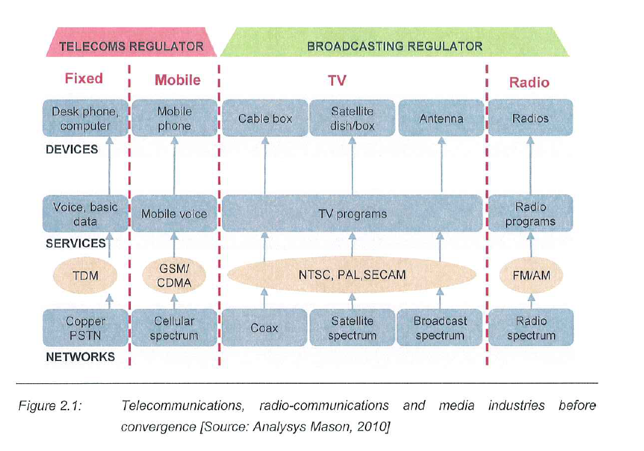
IMPACT OF CONVERGENCE

Slide 19
THE PROCESS OF CONVERGENCE
NETWORK CONVERGENCE
NGN NETWORK- THE ABILITY TO CARRY IP PACKETS OF VARIOUS NETWOKRS what are the protocols used. How we make the interconnection billing
SERVICE CONVERGENCE
THE INCREASED ABILITY TO OFFER ANY SUBSET OF VOICE, DATA,VEDIO SERVICES OVER A PARTICULAR IP ENABLED NETWORK. Any examples?

Slide 20
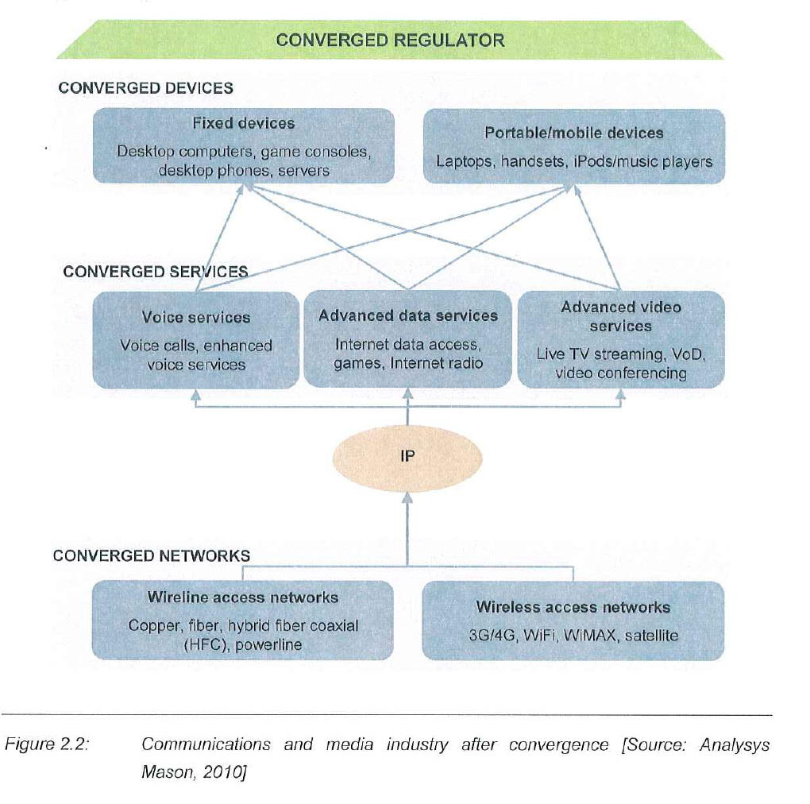
STRUCTURE OF CONVERGED MEDIA & COMMUNICATION NETWORK

Slide 21
NGN ACCESS NETWORK TRANSFORMATION
WIRE LINE WITH VARIOUS DSL TECHNOLOGIES
Inversely proportional to the access length, normally up to 2 km access this will be useful.
FIBRE TO CURB
Re engineering the the existing primary cable network can be easily done. Installation of msan has to be analysed, resulting in shortening the copper loop
FIBRE TO HOME FTTH more drastic changes to the existing network.

Slide 22
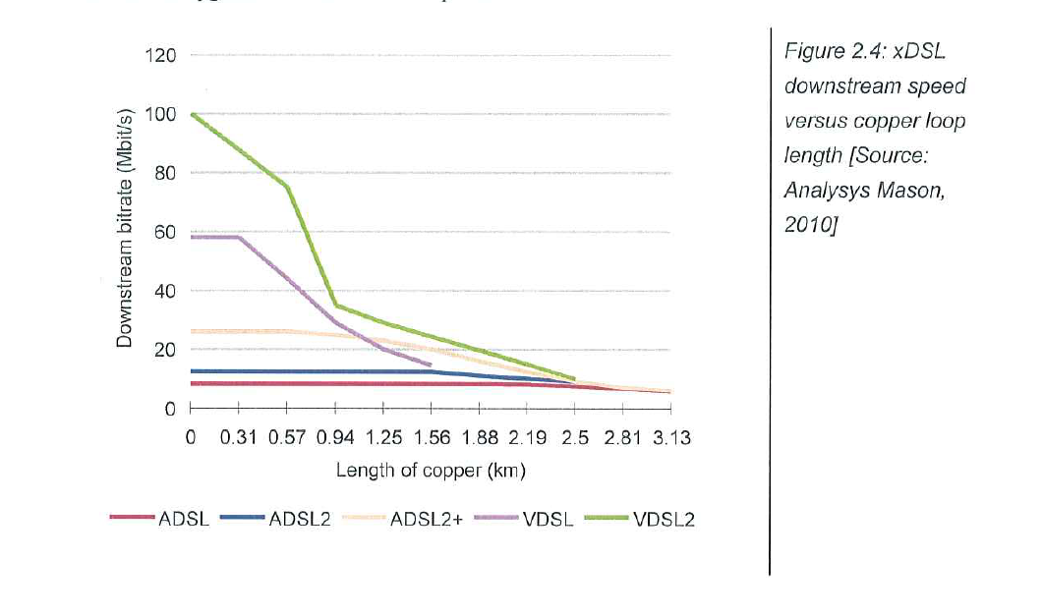
APPLICATION OF VARIOUS TECNOLOGIES INTO WIRED NETWORK

Slide 23
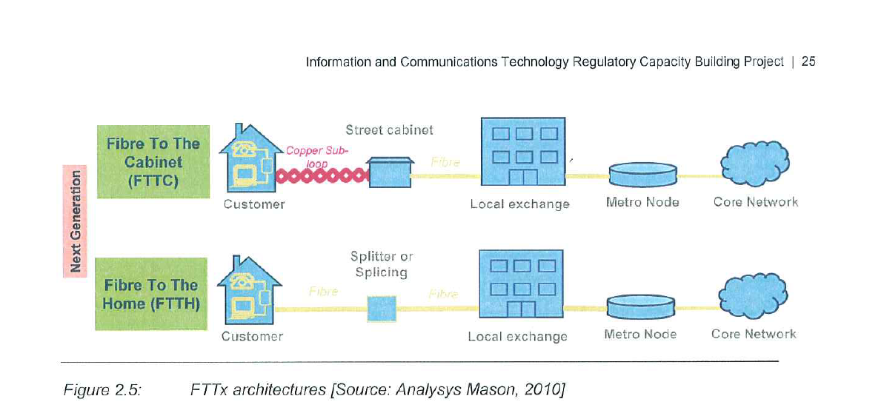
NGN WIRE NETWORK

Slide 24
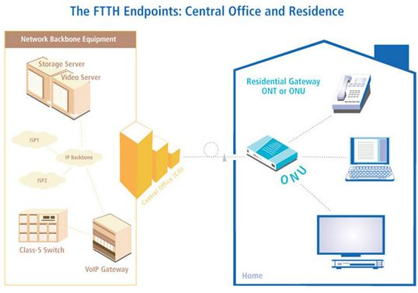
FTTH, PON(passive Optical Network)

Slide 25
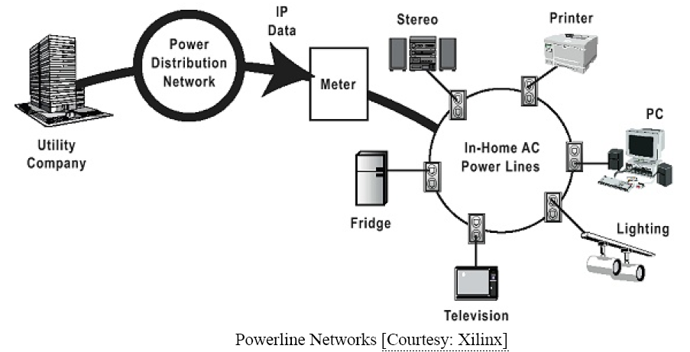
Power Line Communication System

Slide 26
Core networks
Defenitions- 3 main functions
Providing connectivity between two access network islands that are geographically dispersed in a national network , in voice network now transforming from tdm to packet, and isp from atm to ip
Providing core capabilies such as authentification,switching & routing
Providing interconnection with other networks

Slide 27
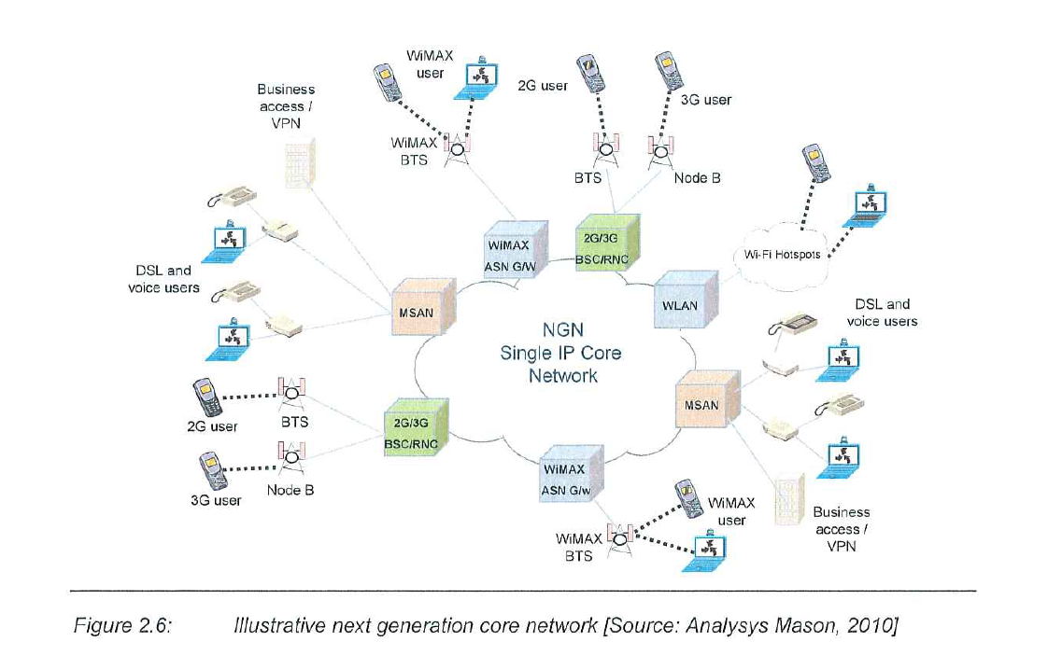

Slide 28
The key attribute of NGN
CIRCUIT SWITCHES ARE REPLACED BY SOFT SWITCH USING IP PACKETS
THE SOFT SWITCHES ARE MODULAR AND CAN HANDLE BOTH WIRELESS AND WIRELINE TOGETHER
IN THE SAME RACK THE PLUG IN CARDS ARE REPRESENT FOR DIFFERENT NETWORK COMPONENTS SUCH AS CALL SERVER, MEDIA GATE WAY,SWITCH, INTERNATINAL GATEWAY.
CONVERGING THE SWITCHING FUNCTIONS OF DIFFERENT NETWORKS INTO A SINGLE RACK

Slide 29
ADVANTAGE OF SOFT SWITCHES
DISTRIBUTING THE FUNTIONALALIES SUCH AS PHYSICAL CONNECTION, CONTROL OF THE SESSION, SWITCHING FUNCTIONS ACROSS THE NETWORK, WHERE AS THOSE FUNCTIONALITIES ARE CENTRALISED IN THE CIRCUIT SWITCHING NETWORK.
THE MAJOR CST SAVING DERIVED FROM NGN IS DUE TO CONVERGING DIFFERENT NETWORKS TO A SINGLE THUS TO MAINTAIN ONE NETWORK, REDUCTION OF NUMBER OF ELEMENTS TO MAINTAIN, REDUCTION THE NUMBER OF OVERALL SITES(AS NO SPECIFIC SITE IS DEDICATED TO A SPECIFIC NETWORK),IP NETWORK ELEMENTS ARE CHEAPER THAN THEIR COUNTER PARTS
THE MAJOR ADVANTAGE TO THE PSTN OPERATER IS THAT EARLIER THE NETWORK WAS CARRING ONLY VOICE WITH CICUIT SWITCH, NOW CARRIES MULIPLE SERVICES WITH PS

Slide 30
CHALLENGES TO OVERCOME IN NGN
DEDICATED SERVICE TO SHARED SERVICES
IN THE CONTEXT OF REAL TIME SERVICES SUCH AS VOICE, IT IS IMPORTANT TO IMPLEMENT THE PROTOCOL FOR REAL NETWORK APPLICATION TO BE DIFFERENCIATED WITH RESPECT TO OTHER APPLICATIONS.
FOR REAL TIME APPLICATIONS IT SHOULD ENSURE FAST SWICHING MECHANISM TO MINIMISE PACKET DELAY AND JITTER FOR END TO END APPLICATIONS.

Slide 31
MPLS APPLICATIONS
MPLS IS THE KEY TECHNOLOGY USED IN NGN AS IT CAN DIFFERENTIATE BETWEEN DIFFERENT SERVICES PRIOTISING REAL TIME TRAFFIC TO THE OTHER TRAFFIC
IMPLEMENTATION OF CLASS OF SERVICES IS IMPORTANT IN MPLS.
KPI FOR MPLS IS GIVEN IN ITU T 1541, IT DEFINES 5 CLASS OF SERVICE FOR DIFFERENT TRAFFIC
FOR EACH CLASS OF SERVICE IT DEFINES ,upper bound packet transfer delay(TD), PACKET DELAY VARIATION(DV), PACKET LOSS RATIO AND PACKET ERROR RATE
4 CATEGORIES ARE DEFINED IN QOS i.e TIME SENSITIVITY, JITTER SENSITIVITY, SERVICE INTERACTIVITY, PACKET LOSS SENSITIVITY
FOR HIGHLY INTERACTIVE SERVICES SUCH AS VOIP & SIGNALLING APPLICATIONS, THE PACKET TRANSFER DELAY IS THE KEY, AS IT DETERMINE HOW INTERACTIVE SESSION CAN BE. THIS EXPLAIN THE LOWER UPPER BOUND (TD) FOR THESE CLASS OF SERVICES.(CLASS0)

Slide 32
VOIP ISSUES
ANY NETWORK WHICH IS DESIGNED TO CARRY IP DATA CAN CARRY VOICE, SINCE IT REQUIRES VERY LOW BAND WITH.
THERE ARE SEVERAL VOIP FLOURS AVAILABLE IN THE MARKET
CARRIER INTERNAL VOIP IS TRANSPARENT TO THE END USER.
THERE ARE TWO OTHER KINDS OF VOIP i.e, enterprise voip (which replace the pabx functions), mass market voip service.
MASS MARKET VOIP EPITOMISE THE BENEFIT OF CONVERGENCE AND CERTAIN CASES OFFERED INDEPENDENT TO THE OWNERSHIP OF THE NETWORK. THIS MAY RESULT IN INCREASING THE COMPETITION. THIS MAY HAVE GREATEST IMPACT ON CONVERGED NETYWORKS.

Slide 33
MASS MARKET RETAIL VOIP (DIRECT ACCESS)
THE MOST COMMON MODEL.
BROAD BAND ACCESS IS SOLD BY THE SAME OPERATER FOR VOICE CALLS.
IN THIS THE BB ACCESS IS BUNDLE WITH INTERNET AND VOICE AND CUSTOMER IS ALLOWED TO USE IT AS VOICE.
FULL TRIPLE PLAY BUNDLE (WITH IPTV) ARE INCREASINGLY COMMON IN MANY MARKETS AND IT WILL BE OF GREAT ADVANTAGE IF ALL 3 BELONGS TO 1 OPERATOR LIKE SLT, WHERE THE GREATER CONTROL FOR QOS VOICE CAN BE ACHIEVED

Slide 34
MASS MARKET INDIRECT ACCESS
ISP USERS USING DIFFERENT PLAYERS BB SERVICE
THE CUSTOMER CONTINUES THE PAY THE PSTN CHARGE TO THE INCUMBERNT
THESE SERVICES WILL HAVE THE FOLLOWING FEATURES IN COMMON. i.e PSTN ANALOGUE TELEPHONE, THE ANALOGUE TELEPHONE ADAPTOR SIT BETWEEN BB CONECTION & THE TELEPHONE, THE BOX CAN BE TAKEN TO ANY BB KEEPING THE LOCAL TELEPHONE PLAN AND THE NUMBER, THE VALUE ADDED SERVICES AND WEB PAGES ARE RELATIVELY EASY TO ADD.
THESE SERVICES ARE CONTINUE TO GROW AND PRICING OF SERVICES MAINLY IN INTERNATIONAL CALLS.

Slide 35
MASS MARKET VOIP DO IT YOUERSELF
DIY MODEL- THE SUPPLIER PROVIDES THE SOFTWARE THAT ENABLE THE CUSTOMER TO HAVE FREE CALLS WITH THE END USERS WITH SAME KIND OF SOFTWARE.
CALL CAN BE ORIGINATED BY ANY BB CONECTION UNLESS OTHERWISE RESTRICTED BY THE OPERATER.
MANY PROVIDERS OFFER PAY FACILITES TO RECEIVE AND ORIGINATE PSTN/MOBILE CALLS

Slide 36
BASIC AREAS OF NGN
THE FOLLOWING NETWORK ELEMENTS WILL CONVERGE TO PROVIDE THE NGN NETWORK
CORE NETWORK
ACCESS NETWORK
TERMINAL EQUIPMENT
NORMALLY THE NETWORK PROVIDERS WERE PROVIDING THE BASIC VOICE SERVICES.
OTHER OPERARATERS CAN PROVIDE VALUE ADDED SERVICES, COMBINING ALL TRIPLE PLAY DERIVING FROM NGN

Slide 37
WHERE ARE WE HEADING?
MAJOR ISSUE AS AT NOW WITH REGARD TO CONVERGENCE AND VOICE SERVICES ARE THE QUALITY ISSUE.
VOIP CAN PROVIDE CD QUALITY SOUND
OVER THE GENERAL INTERNET THE LATENCY PROBLEMS AND QOS CAN RAISE THIER HEADS.
SOME OF THESE PROBLEMS ARE NOW BEING RESOLVED BY CLEVER CODING SYSTEMS DEVELOPED TODAY
VOIP IS GOING TO BE INEVITABLE SOLUTION FOR THE VOICE IN TIME TO COME

Slide 38
Further studies (using the WEB)
Compare the following access technologies
GSM
CDMA
WIMAX
Explain the basic differences
What is NGN?

